Slide 1
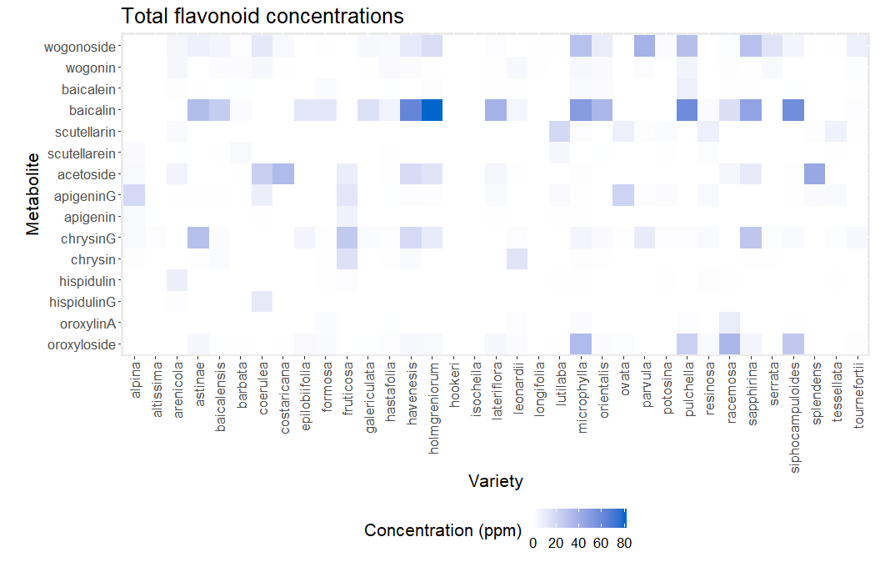
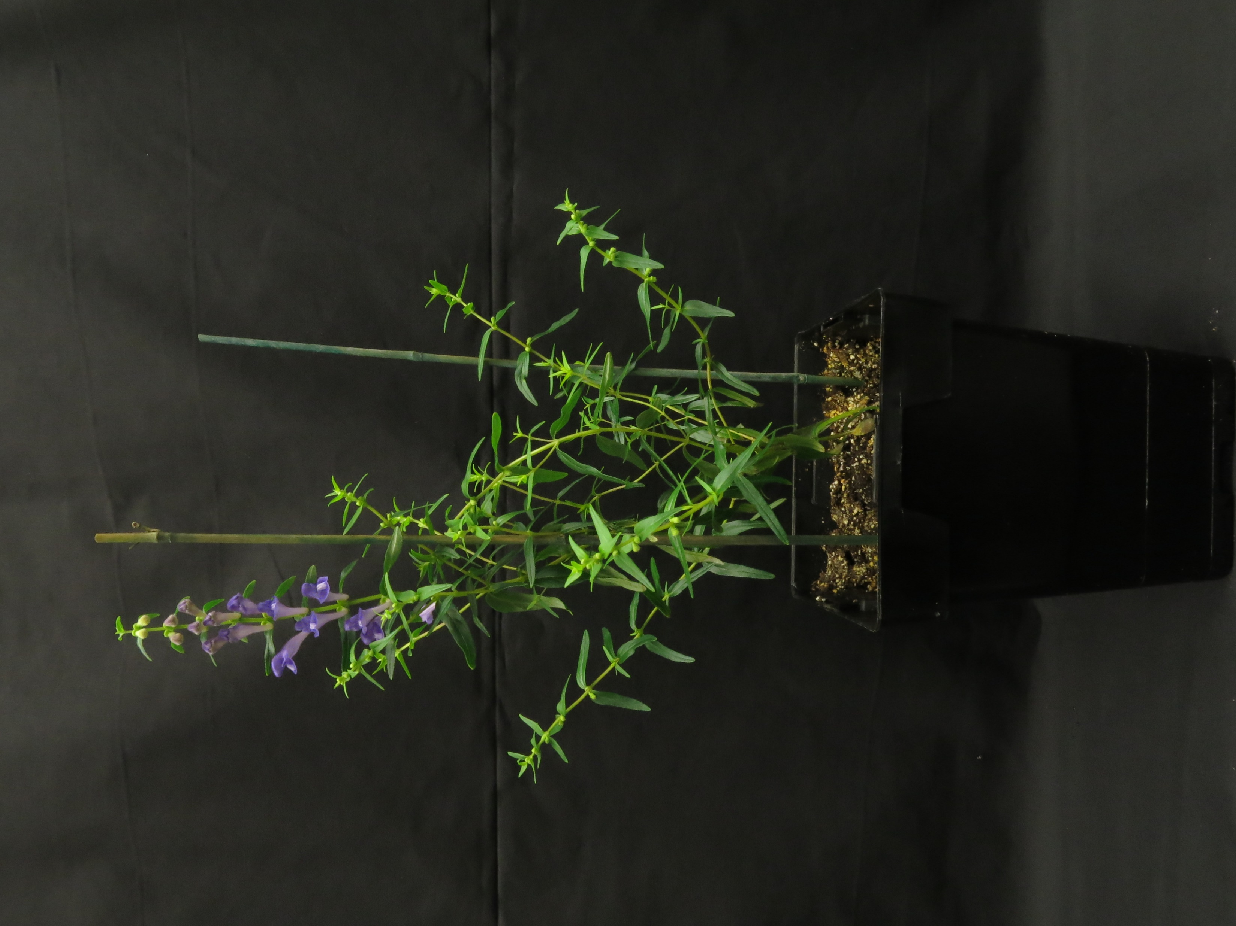
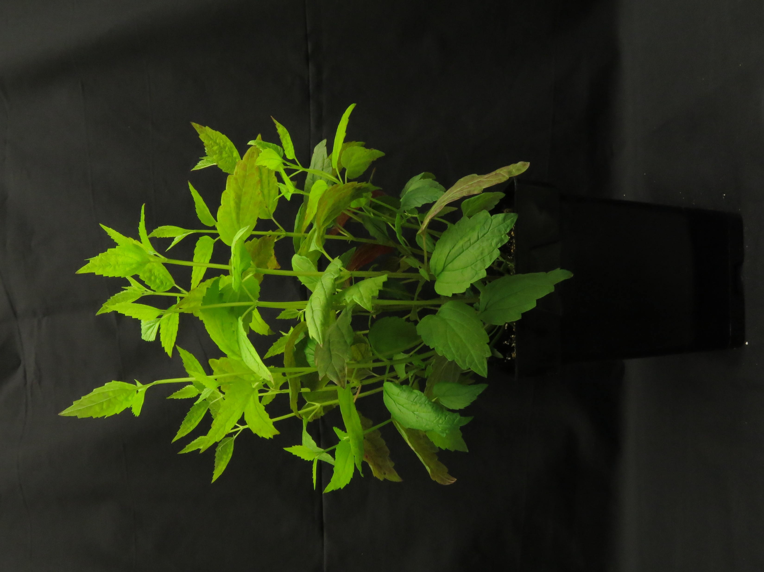
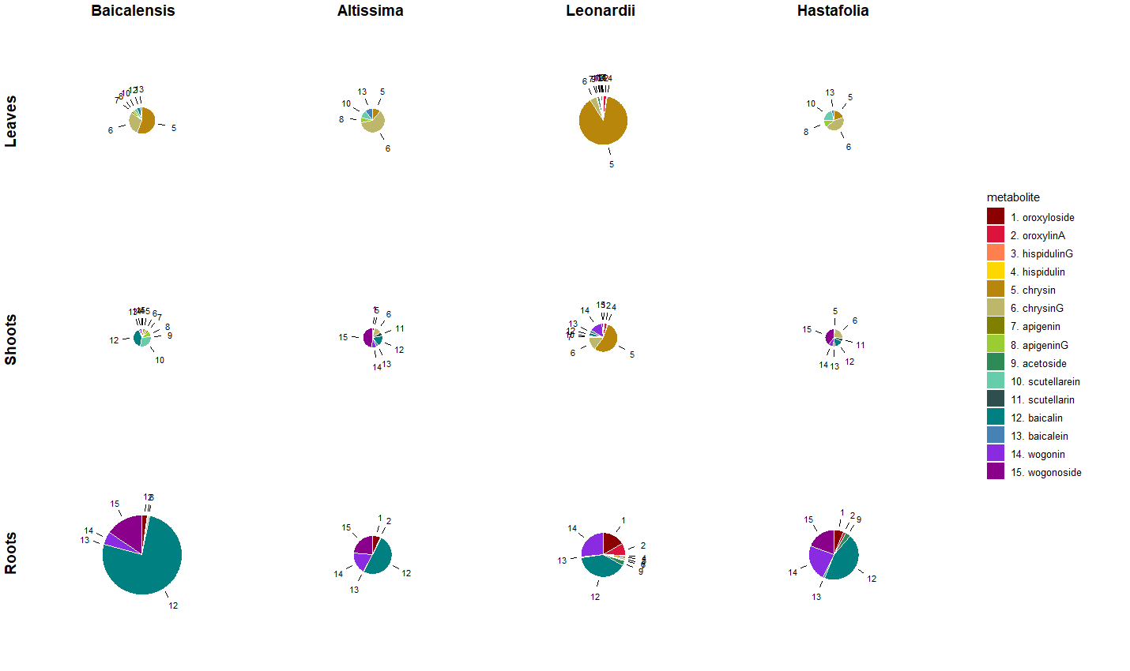
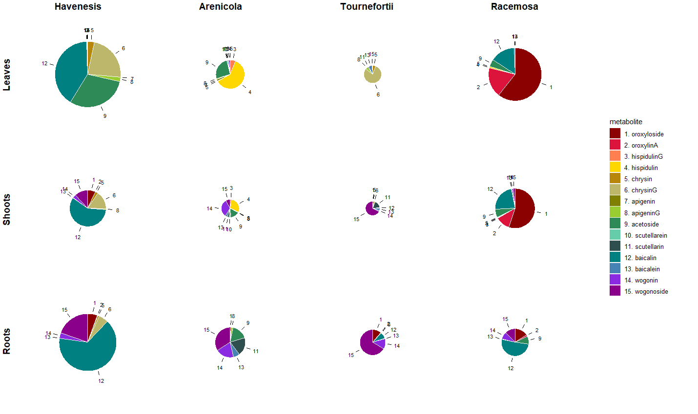
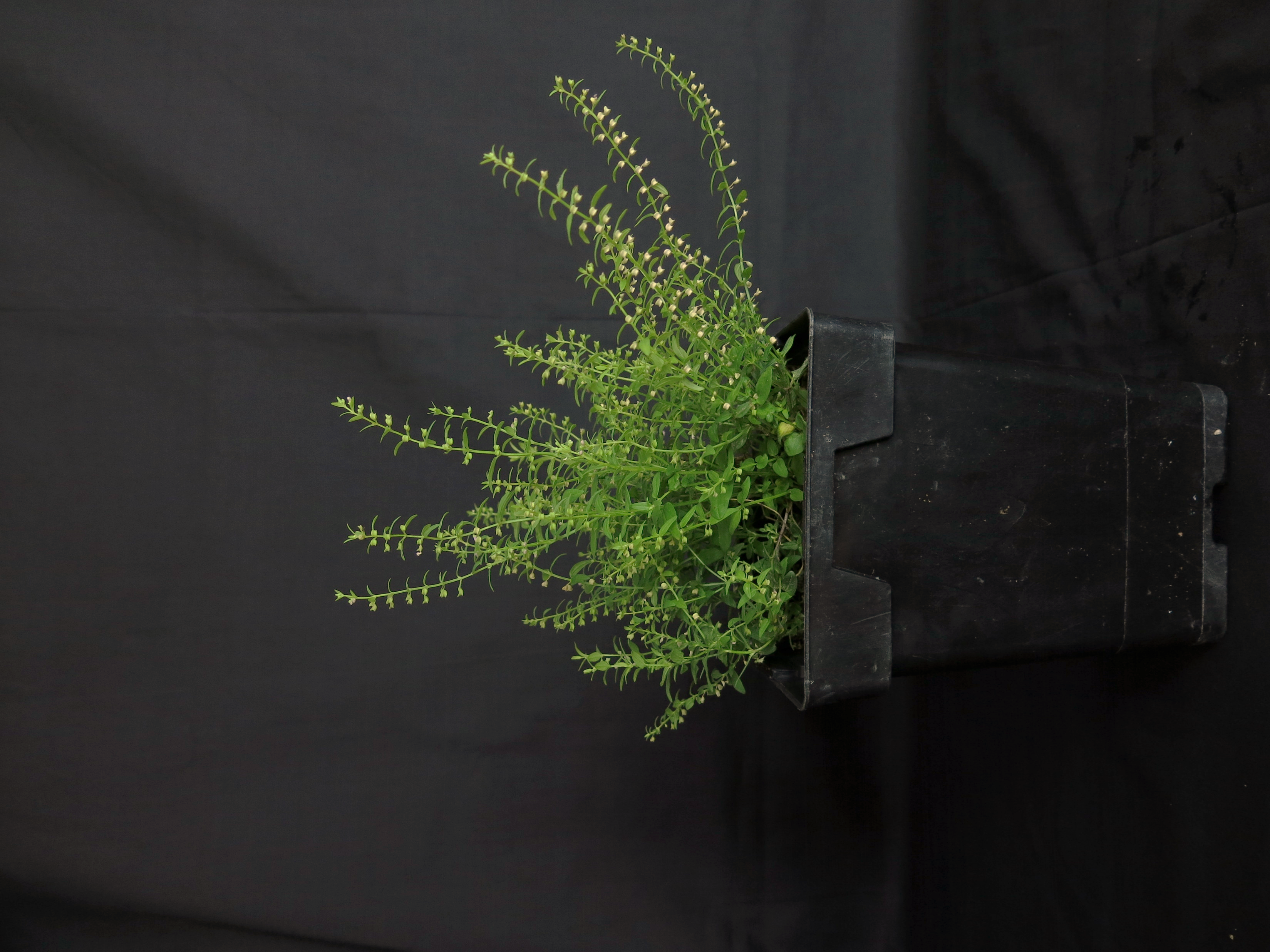
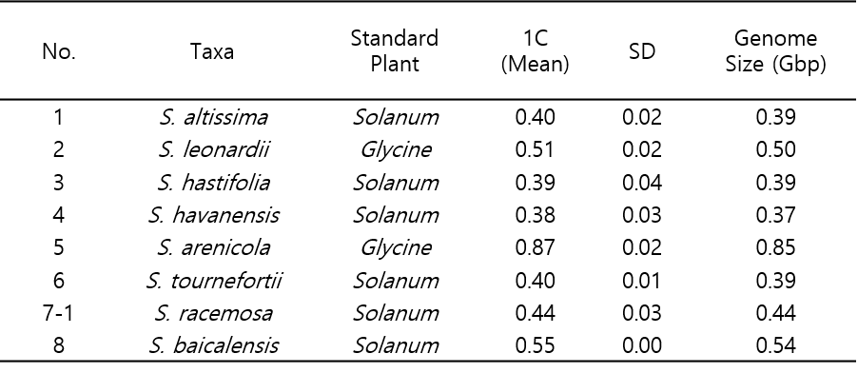
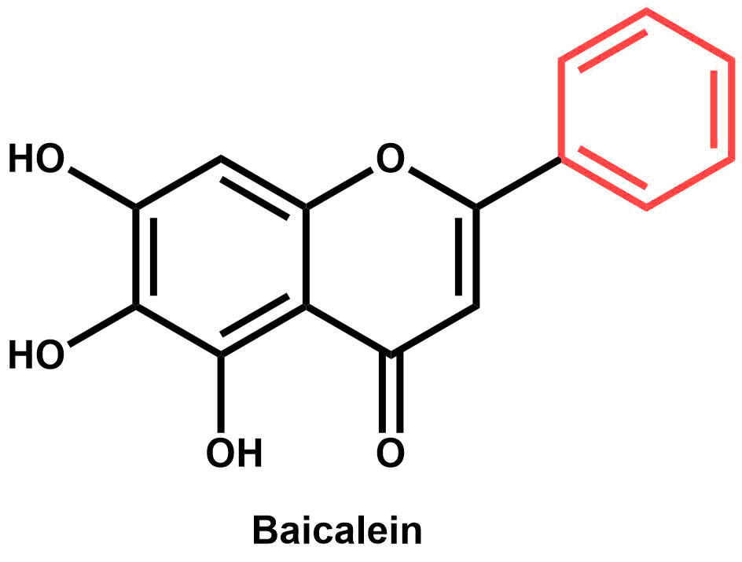
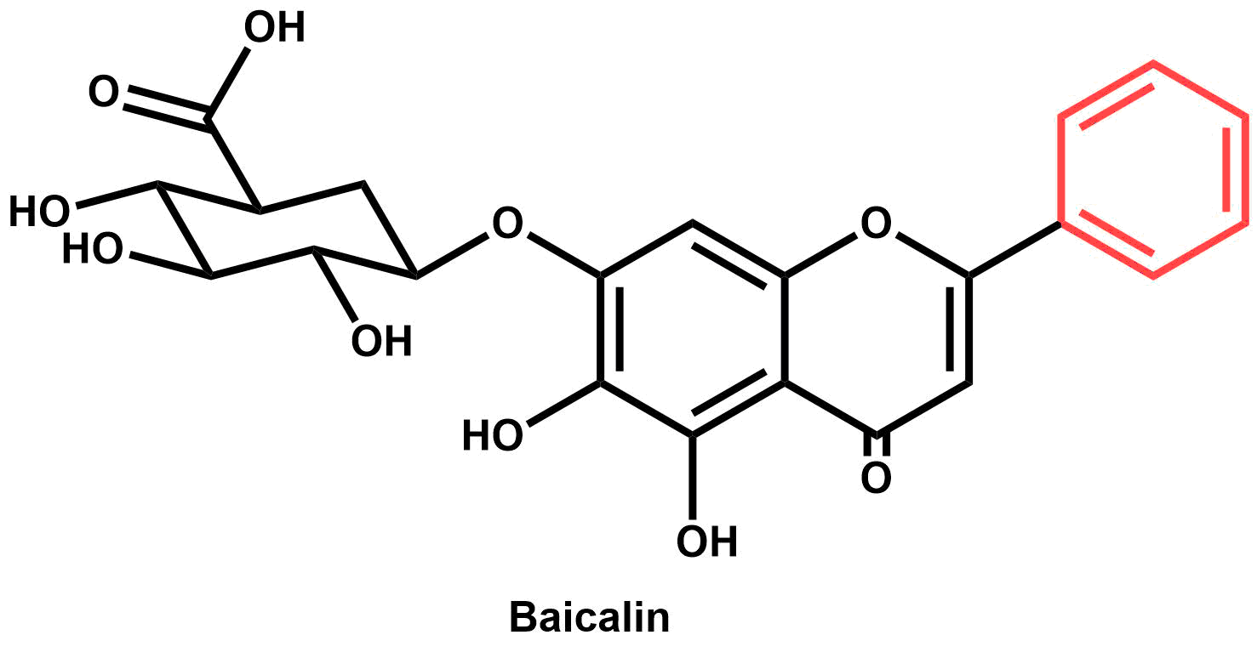
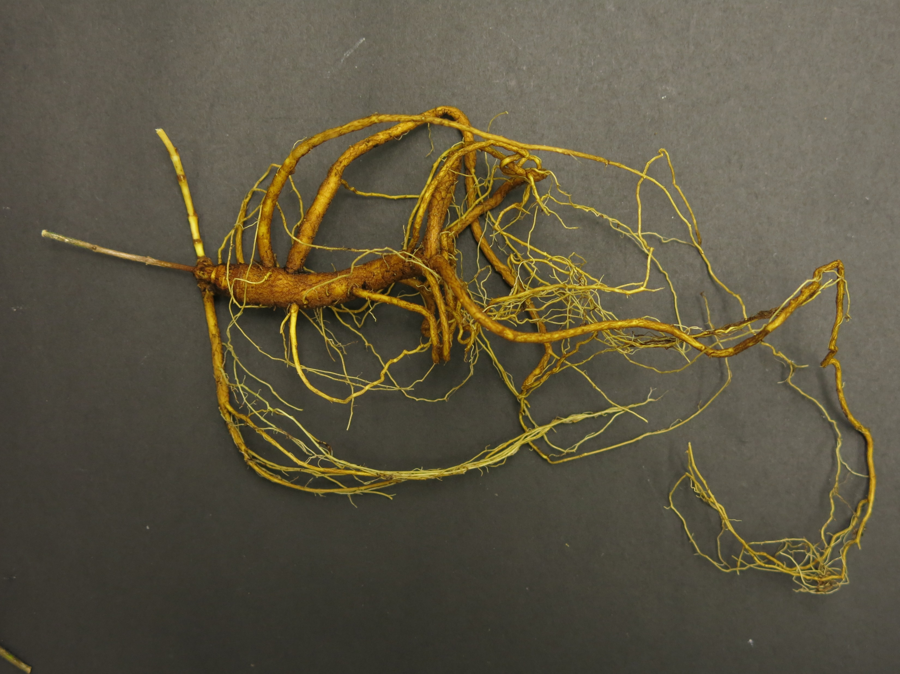
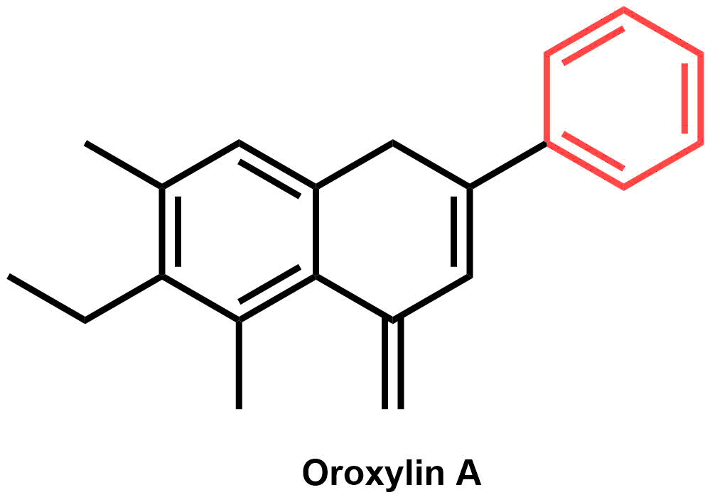
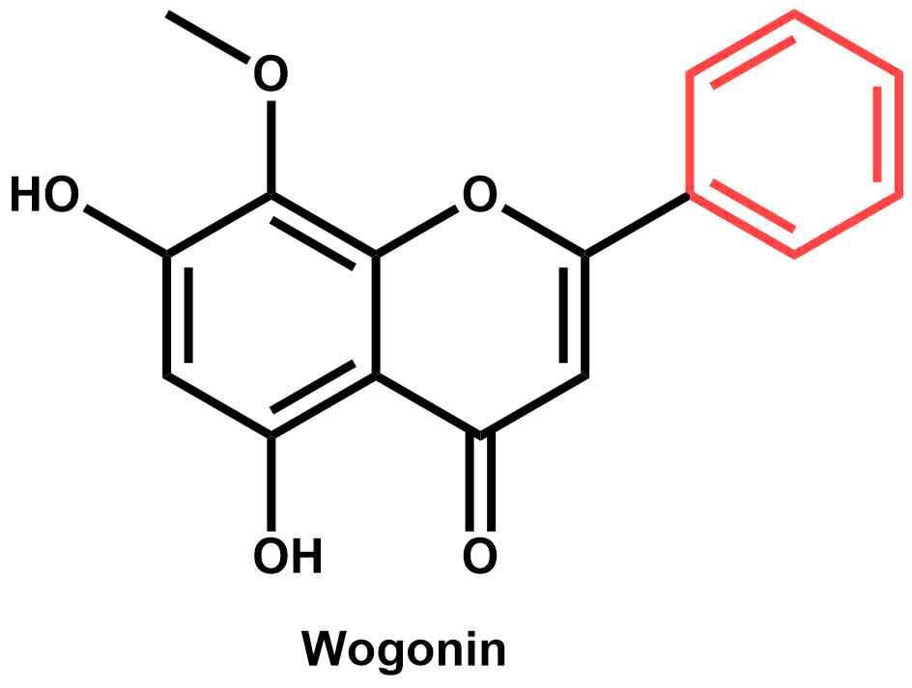
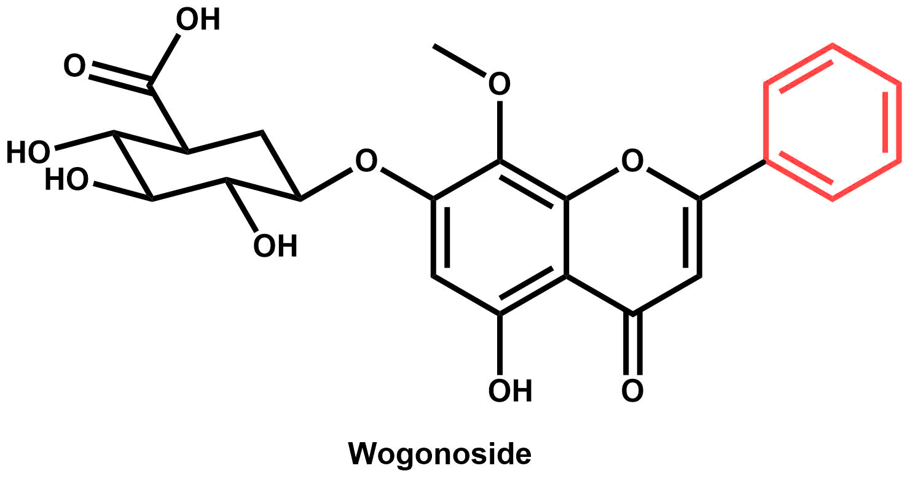

An investigation of flavonoid diversity in Scutellaria to identify species with medicinal potential
Bryce Askey, Yeong Hun Song, Yoonkyung Lee, Ru Dai, Sangtae Kim, and Jeongim Kim
Author affiliations
Abstract
Methods and Results
Scutellaria baicalensis is a medicinal plant whose root extracts have been widely used in Asian medicine for more than 2,000 years. Although S. baicalensis has been well-studied, the majority of the 470 species in the Scutellaria genus have not been analyzed. This study aims to extend the current knowledge of Scutellaria by analyzing flavonoid profiles and genome sizes of a large set of species representing the diversity in the genus. Targeted metabolite analysis via High Performance Liquid Chromatography (HPLC) was used to quantify concentrations of 15 medicinally relevant flavones. The genome sizes of eight of the species analyzed were also estimated with flow cytometry. A comparison of phytochemical profiles indicate diversity in site and identity of accumulation for multiple species when compared to S. baicalensis. Inconsistences in site of accumulation imply significant differences in biosynthetic pathway exists for several species. Researchers studying Scutellaria can use the results of this work to identify previously uncharacterized species with medicinal potential, aiding in the development of new drugs and treatments.
Chemical analysis of total samples
Targeted metabolite analysis was performed using High Performance Liquid Chromatography (HPLC)
Concentrations of 15 medicinally relevant flavonoids were quantified
34 species of Scutellaria were analyzed
Dried (herbarium) samples prepared at 1000 ppm (1 mg sample / 1 mL solvent)
Fresh samples prepared at 5000 ppm (5 mg sample / 1 mL solvent)
Organ-specific chemical analysis
Out of 34 species, 8 were selected for further analysis
HPLC used to quantify flavonoids in different organs of plant - leaves, shoots, and roots
Significant differences in site of accumulation imply differences in flavonoid biosynthetic pathway
Background
Scutellaria baicalensis is a medicinal plant
Root extracts used in traditional Chinese medicine
Huang Qin – commercially sold powder of S baicalensis roots
The medicinal properties of S. baicalensis are well-studied
Proven medicinal effects: anti-Alzheimer’s, anxiolytic, anti-cancer, and angiogenic
Specific phytochemicals responsible have been identified
Reference genome recently completed
Proposed flavonoid biosynthetic pathway explains organ-specific accumulation
However, the Scutellaria genus contains >470 species
Little is known about the medicinal relevance of most of the genus
Phytochemical profiles are not well-studied/not studied at all
Goal: Analyze a large set of Scutellaria plants representing the diversity in the genus to identify species with medicinal potential for further study
Objectives: replace with boxes with arrows
Identify species of interest by quantifying medicinally relevant flavonoids in total (i.e. not organ-specific) samples
Analyze organ-specific samples from species of interest to determine site of accumulation of medicinally relevant flavonoids
Estimate genome size for species of interest to evaluate ease of further genetic study/improvement
A.
B.
Figure 3 . Heatmap of flavonoid concentrations for 34 Scutellaria species analyzed
C.
Figure 1. Morphological differences between (A) S. baicalensis, (B) S. lateriflora, and (C) S. racemosa plants illustrate the diversity of the Scutellaria genus.
Figure 4. Scaled pie charts for organ-specific data
Estimation of genome size
Genome sizes for the 8 selected species were measured with flow cytometry
6 of the 8 species had similarly sized genomes to S. baicalensis
S. arenicola is likely tetraploid
Overall genome sizes are small
Table 1. Genome sizes for species of interest
Baicalein
Conclusions
Baicalin
Discrepancies in proposed biosynthetic pathway for S. baicalensis and metabolite profiles for … imply …
Genome size is similar to S. baicalensis for 7 of the 8 species analyzed
Future work – phylogenetic tree
Oroxylin A
References and Acknowledgements
Wogonin
Wogonoside
(Shang et al., 2005; Gasiorowski et al., 2011; Awad et al., 2003; Cole et al., 2007, Zhao et al., 2016;)
Anti-Alzheimer’s
Anxiolytic (anxiety reducing)
Anti-cancer
Angiogenic (promoting formation of new blood vessels)
Figure 2. S. baicalensis root extracts contain a variety of metabolites with medicinal properties.

